Slide 1
California State University, Sacramento Computer Science Department
CSC 179 - Software Testing and Quality Assurance
Summer 2022
Introduction:
System Engineering,
Software Engineering, Process and CMM Models
Lecture # 1

Slide 2
Software
Software
includes computer programs, associated software documentation and data of a system
Software Products
Generic/stand alone systems
Sold on the open market (shrink wrapped)
Customized
Commissioned by a customer

Slide 3
System
System
A collection of elements related in a way that allows a common objective to be accomplished.
In computer systems, these elements include hardware, software, people, facilities, process.
Complex systems
include subsystems, which are also systems. (Software System Engineering deals with software subsystem)

Slide 4
System Elements
Elements of a system
are not just hardware but can also include software, and can even include people, facilities, policies, documents and databases.
System
an integrated set of elements that accomplish a defined objective. The objective is what is to be created.

Slide 5
System Elements
Subsystem
is a system, except that it normally will not provide a useful function on its own, it must be integrated with other subsystems (or systems) to make a system.
Components
are elements that make up a subsystem or system.
Parts
are elements on the lowest level of the hierarchy

Slide 6
Types of Systems
Open systems
Closed systems
Conceptual systems
Physical systems
Static systems
Dynamic systems

Slide 7
Types of Systems
Open Systems Examples
………….
Closed Systems Examples
………….
Conceptual Systems Examples
………….

Slide 8
Types of Systems
Physical Systems Examples
………….
Static Systems Examples
…………..
Dynamic Systems Examples
…………..

Slide 9
System Engineering
System Engineering
Concentrate not only on the software but rather on the system as a whole and its elements…
SE occurs as a result of a process called system engineering.

Slide 10
System Engineering
System Engineering
A logical process of activities which transforms a set of requirements arising from a specific mission objective into a full description of a system which fulfills the objective in an optimum way.
It ensures that all aspects of a project have been considered and integrated into a consistent whole.

Slide 11
System Engineering
The system engineering discipline covers the development of total systems, which may or may not include software.
Systems engineers
focus on transforming customer needs, expectations, and constraints into product solutions and supporting those product solutions throughout the product life cycle.

Slide 12
System Engineering
Bring a unique focus:
Good system engineering begins with a clear understanding of the "world view" and progressively narrows until technical detail is understood.
A disciplined focus to the product.
A consistent vision of stakeholder's expectations independent of daily project demands. (cost, schedule, and performance)

Slide 13
Systems & Modeling
How system modeling is useful in system engineering?
Presents a visual presentation of the envisioned system.
Modeling allows engineers to assess the system
Evaluate system components in relationship to one another.
Simplify complexity
Examples of models: SCD, SFD, UML models, etc.
[Continued…]

Slide 14
Systems & Modeling
Build models to better understand the system being developed.
Build models of complex systems because it hard to comprehend such a system in its entirety.

Slide 15
Systems & Modeling
Four aims:
Assists engineers to visualize a system.
Allows engineers to specify the structure/behavior of a system.
Provides engineers with a template that guide in constructing systems.
Ensures documentation of the decisions that engineers make.

Slide 16
Systems & Modeling System Context Diagram (SCD)
System Context Diagram (SCD)
It establishes the information boundary between the system being implemented and environment in which the system operate.
It defines all external producers of information.
It defines all external consumers of information.

Slide 17
Systems & Modeling System Context Diagram (SCD)
Systems Context Diagrams are a fundamental early product that systems engineers need to develop to start the project with common understanding about the project
The primary goal of the system context diagram is to focus attention on external factors and events that should be considered in developing a complete set of systems requirements and constraints.

Slide 18
Systems & Modeling System Context Diagram (SCD)
The SCD is often viewed as a block diagram, showing a system, and its inputs and outputs from/to external factors.
It is the highest-level view of a system.
SCDs are considered an excellent communication tools with stakeholders.

Slide 19
Systems & Modeling System Context Diagram (SCD)
Used early in the project lifecycle to develop and document an agreement on the scope of the system requirements.
An SCD does not provide information about the sequence or timing of processes.
Therefore, it should not be confused with a flowchart or process flow diagram.

Slide 20
Modeling – “Structured Approach”
Process
specification
(PSPEC)
Data Object
description
ERD
Data dictionary
DFD
STD
Control Specification (CSPEC)
Fig. 1

Slide 21
Modeling - “Object-Oriented Approach”
Function
Class diagram
Object diagram
Use case diagram
Activity diagram
Data
Object
Behavior
State-chart diagram
Interaction diagram
Fig. 2

Slide 22
System Thinking
System thinking is a method of critical thinking by which one can analyze relationship between system’s parts to understand the situation for better decision making.
22

Slide 23
System Thinking
Characteristics of System Thinking:
Shift perspective from Parts to Whole
System’s properties cannot be reduced to part’s properties. System’s properties cannot be applied to individual parts. Thinking of the whole system.
Shift perspective from Objects to Relationship
Parts interact with each other to create relationship. Objects build the network.
Shift perspective from Structures to Process
Continual flow of things in system is more important than configuration or object structure.
23

Slide 24
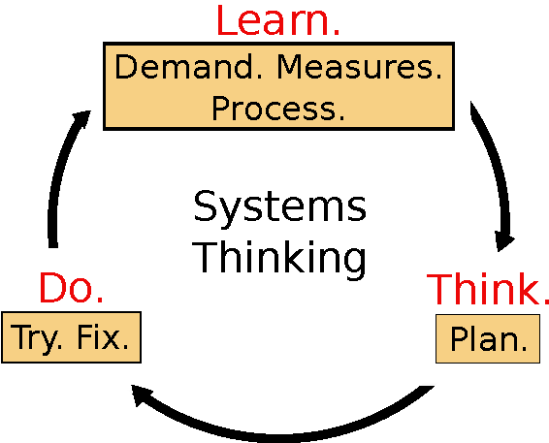
System Thinking
System Thinking is an approach to work that considers the whole system of which the work is a part and provides tools to map out and improve that system.[1]
Fig. 3
24

Slide 25
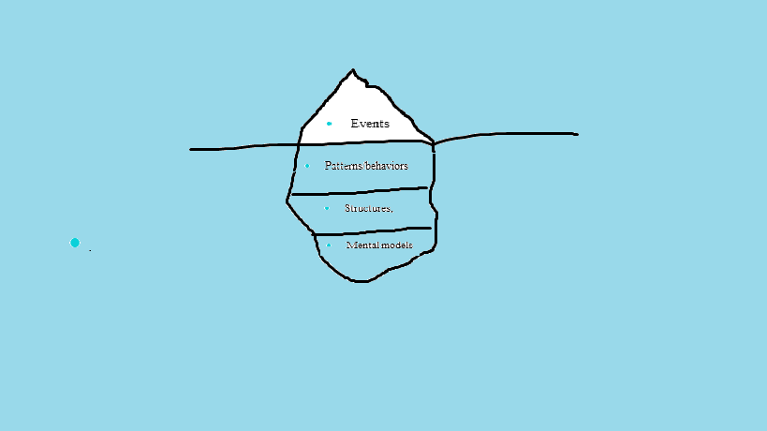
Iceberg Model
Iceberg is used as an analogy to represent underlying structures generating perceived events and issues
Fig. 4

Slide 26
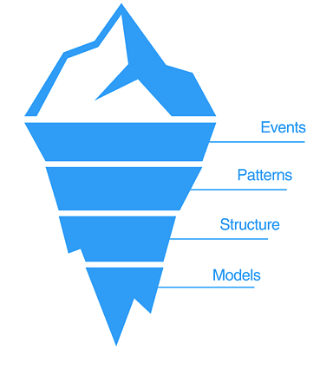
Iceberg Model
Four basic levels to situations:
Events : components & actions observable to us
Discrete activities or facts about the state of things in system
What happens or what we see
Patterns of Behavior: describes trends over time
Pattern of recurrence of events
What is happening ? What is changing?
Allows to anticipate, plan & forecast
Fig. 5
26

Slide 27
Iceberg Model
System Structure: parts interrelated to influence pattern
Composed of cause-and-effect relationships, connections between patterns.
Reveals underlying structure of problems.
Mental Models: supports everything through beliefs, values, assumptions
Thinking that creates structures that manifest in pattern of events.
Assumptions and beliefs that drive behavior and keeps the structure from doing what it does.
27

Slide 28
System Development and Process?
(Webster)
A system of operations in producing something; a series of actions, changes, or functions that achieve an end or a result
(IEEE)
A sequence of steps performed for a given purpose
28

Slide 29
What is a Software Process?
(SEI) - A set of activities, methods, practices, and transformations that people use to develop and maintain software and the associated products (e.g., project plans, design documents, code, test cases, and user manuals).
As an organization matures, the software process becomes better defined and more consistently implemented throughout the organization.
Software process maturity is the extent to which a specific process is explicitly defined, managed, measured, controlled, and effective.
29

Slide 30
Process Principles
Prescribes all major activities
Uses resources, within a set of constraints, to produce intermediate and final products.
May be composed of sub-processes.
Each activity has entry and exit criteria.
30

Slide 31
Process Principles
Activities are organized in a sequence.
Has a set of guiding principles to explain goals.
Constraints may apply to activity, resource or product.
31

Slide 32
Design Thinking
Definition:
Design Thinking represent a set of cognitive, strategic and practical processes by which design concepts are developed.[2]
It helps to identify the problem of users, which leads to generate an idea and then tackle a problem by testing range of ideas and gathering feedback.
32

Slide 33
Design Thinking
Stages of Design Thinking
Empathize – conduct research to understand users.
Define – combine research and observe users’ problems.
Ideate – generate innovative and creative ideas.
Prototype – build a model based upon ideas.
Test – return it to users for feedback.
Implement – start implementing the idea.
33

Slide 34
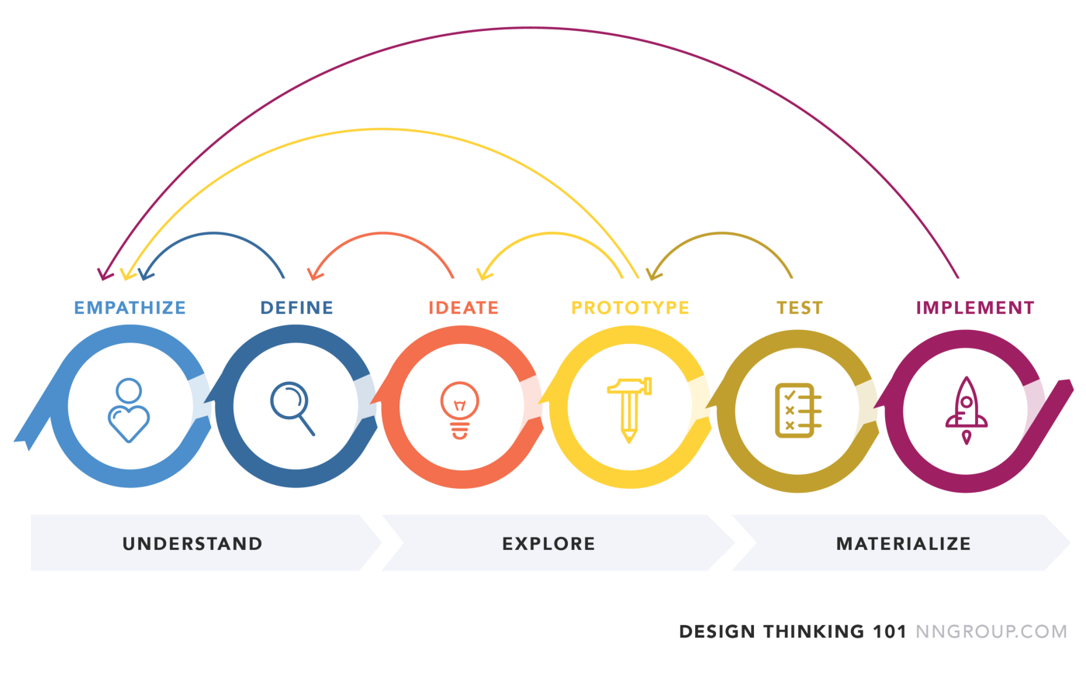
Stages of Design Thinking
Fig. 6 [3]
34

Slide 35
Benefits of Design Thinking
It helps to view different perspective of people and often leads to creative and innovative ideas to tackle a problem.
Feedback from users in early stage before implementation results in saving of money, resources and time.
35

Slide 36
System Thinking and Design Thinking
Similarities
Both system thinking and design thinking includes the process tackling the problems over the course of learnings from feedbacks.
Differences
System thinking is about breaking systems down to their components to understand the bigger picture while design thinking is about creating and building.[4]
36

Slide 37
System Thinking and Design Thinking
Similarities
Critical thinking is a key component for system as well as design thinking.
Differences
System thinking has wide spectrum of focus because of considering different strategies, while design thinking has narrow spectrum due to focuses only on user focused needs.[4]
37

Slide 38
Capability Maturity Models CMM & CMMI
Capability Maturity Model (CMM) & Capability Maturity Model Integration (CMMI)
Developed by SEI – (Software Engineering Institute at Carnegie Mellon)
The CMMI project is sponsored by the U.S. Department of Defense (DoD) and the National Defense Industrial Association (NDIA).
38

Slide 39
Capability Maturity Model (SW-CMM)
Developed in 1987 by the Software Engineering Institute (SEI) at Carnegie-Mellon University under the sponsorship of DARPA
Described in the book Managing the Software Process in 1989 by Watts Humphrey
Published as a separate document: Capability Maturity Model for Software in 1991
39

Slide 40
Why Capability Maturity Models
The Capability Maturity Model Integration(CMMI) is a process and behavioral model that helps organizations streamline process improvement and encourage productive, efficient behaviors that decrease risk in software, product, and service development.[5]
40

Slide 41
Capability Maturity Models – CMM - Levels
Initial Level (Level 1)
Characterized as ad hoc, and occasionally even chaotic.
Repeatable (Level 2)
Basic project management processes are established to track cost, schedule, and functionality.
The necessary process discipline is in place to repeat earlier successes on projects with similar applications.
41

Slide 42
CMM – Levels
Defined (Level 3)
The software process for both management and engineering activities is documented, standardized, and integrated into a standard software process for the organization.
Managed (Level 4)
Detailed measures of the software process and product quality are collected.
Both the software process and products are quantitatively understood and controlled.
42

Slide 43
CMM – Levels
Optimized (Level 5)
Continuous process improvement is enabled by quantitative feedback from the process and from piloting innovative ideas and technologies.
43

Slide 44
CMMI Maturity Levels
5
Optimizing
Focus on process improvement
4
Quantitatively
Managed
Process measured and controlled
3
Defined
Process characterized for the organization and is proactive
2
Managed
Process characterized for projects and is often reactive
1
Performed
Process unpredictable, poorly controlled and
reactive
Fig. 5
44

Slide 45
References
https://accu.org/journals/overload/19/103/sedge_1975/
https://en.wikipedia.org/wiki/Design_thinking
https://medium.com/@bhmiller0712/what-is-design-thinking-and-what-are-the-5-stages-associated-with-it-d628152cf220
https://medium.com/swlh/design-thinking-vs-systems-thinking-ca13caa17557#:~:text=Design%20thinking%20focuses%20on%20synthesis,to%20understand%20the%20bigger%20picture.
https://www.cio.com/article/274530/process-improvement-capability-maturity-model-integration-cmmi-definition-and-solutions.html
45

Slide 46
Questions?
46

Slide 47
California State University, Sacramento Computer Science Department
CSC 179 : Software Testing and Quality Assurance
Summer 2022
Lecture # 2:
Verification / Validation & Software Testing

Slide 48
V & V
Software Verification Process is a process for determining whether the software products of an activity fulfill the requirements or conditions imposed on them in the previous activities.
Software Validation Process is a process for determining whether the requirements and the final, as-built system or software product fulfills its specific intended use.

Slide 49
Verification- Some Important Questions
“Are we building the system, right?”
Does the design meet the specification ?
Does the implementation meet the specification?
Does the delivered system do what it intended to do ?
Are requirements models consistent with one another ?

Slide 50
Validation- Some Important Questions
“Are we building the right system?”
Does the problem / project statement accurately capture the real problem?
Did the software / product captures need of all the stakeholders?
Does the software/product performs as expected and meets all needs ?

Slide 51
Verification
Software engineering standards known as IEEE-STD-610 defines “Verification” as:
“A test of a system to prove that it meets all its specified requirements at a particular stage of its development”
“at a particular stage of its development” is major element of verification.
Verification often include activities such as code reviews, walkthroughs, inspections and not testing (if any).

Slide 52
Validation
Validation has a different purpose.
Definition of Validation according to IEEE-STD-610 is:
“An activity that ensures that an end product stakeholder’s true needs and expectations are met.”

Slide 53
Validation
Validation is done upon the completion of a specific component or often at the completion of the entire software/product.
Validation has much less focus on the process of completing the software.
The sole focus is on “everything is as expected”
High-level testing –
typically includes regression testing, acceptance testing, performance testing, etc..

Slide 54
Summary – V & V
 | Verification | Validation
As per IEEE-STD-610: Definition: | “A test of a system to prove that it meets all its specified requirements at a particular stage of its development.” | “An activity that ensures that an end product stakeholder’s true needs and expectations are met.”
The Process of: | Ensuring we are developing the product according to specifications. | Testing and validating the actual product to ensure we have developed it correctly.
Involves: | Little or no code execution | Code Execution
Activities Include: | Reviews, Walkthroughs, Inspections, Desk-checking, etc. | Black box testing, white box testing, non-functional testing, etc.
Activity Type: | Low-level | High-level
Method/Process Type: | A static method of checking documents and files | A dynamic process of testing the real product.
Target: | Application, software architecture, specifications, complete design, high level and database design, etc. | Actual product
Answers the Question: | Am I building the product right? | Am I building the right product?

Slide 55
V & V Process
Refinement
Requirement Specification
Design Specification
Implementation
Validation:
Requirement Against itself
Requirement
Review
Design
Review
Code Inspection
Black Box Testing
Verification:
Design Against Requirement
Verification:
Implementation Against Design
Fig. 2

Slide 56
Advantages of V & V
Advantages of Verification
Verification helps in lowering the number of the defects that may be encountered in the later stages of development.[1]
Verification helps in building the product as per the customer specifications and needs.[1]
Advantages of Validation
During verification if some defects are missed, then during the validation process they can be caught as failures.[1]
Validation helps in building the right product as per the customer’s requirement which in turn will satisfy their business process needs.

Slide 57
Advantages of V & V
Advantages of Verification
Verifying the product at the starting phase of the development will help in understanding the product in a more comprehensive way.
Verification reduces the chances of failures in the software application or product.
Advantages of Validation
Validation is done during testing like feature testing, integration testing, system testing, load testing, compatibility testing, stress testing, etc.[1]

Slide 58
V/ V & Software Testing
In the context of testing, “Verification and Validation” are the two widely and commonly used terms. Most of the times, we consider both the terms as the same, but these terms are quite different.

Slide 59
Independent V & V
Independent verification focuses on determining that the software development plan (SDP) aligns with specific end goals.[2]
Independent validation is the latter step in IV&V testing, flowing logically from the verification process. While verification examines the requirements, validation focuses on the final product, ensuring that the software fulfills the requirements determined by the verified SDP. [2]

Slide 60
V/ V & Software Testing
Testing is a process of executing a program with the intent of finding defects.

Slide 61
Software Testing
Testing is a critical & important part of the V & V Process
Consists of a set of activities that have to be planned and conducted systematically (testing strategy)
Includes low level tests (to verify implementation) and high level tests (to validate against the specification requirements document).

Slide 62
Software Testing Challenges
Input domain/space is an infinite set.
The question of “When to stop testing.”
Selecting an efficient and effective subset of test cases
Prediction of software failures
Testing exhaustively is impossible

Slide 63
Purpose of Testing
Defect detection:
- Problem: Testing only shows/suggests the presences of faults not necessarily their absence.
Reliability estimation:
- Problem: Input distribution used for selecting test cases/test inputs may be flawed.

Slide 64
More about Input Domain/Space …
Input domain is very large if not an infinite set
How to select a sample subset
Defining a good selection of test case criteria

Slide 65
When to Stop Testing
Determining when to stop testing is complex
Pass/Fail data is collected and analyzed to quantitatively answer the question of “when to stop testing”
Some Metrics | Other Metrics
Number of defects | Found common errors?
Types of defects | Forced internal data to be initialized and used?
Severity of defects | Found seeded errors?
Components where defects found
Code coverage

Slide 66
Testing Principles
All tests should be traceable to customer requirements.
Tests should be planned long before testing begins.
Testing should begin in the small and progress to larger components.
Testing is more much more effective when conducted early in SDLC.
Testing is a risk-based activity
Testing cannot prove that there are no more defects — it can only show that defects are present!

Slide 67
Software Testing Process -Four Phases-
Designing test cases.
Automating, executing, & evaluating test cases.
Measuring testing progress.
Modeling the software
& the software environment.

Slide 68
Modeling the Software
Test engineers need to understand not only the software, but also the environment in which it operates.
Models should be a depiction of the software’s behavior, which can be described in terms of the input sequences accepted by the system; the actions, conditions, and output logic; or the flow of data through the applications, modules, and routines.
Useful models typically possess properties that make test generation effortless and, frequently, automatable.

Slide 69
Modeling Techniques
Decision Tables – Tables used to show sets of conditions and the actions resulting from them
Finite State Machines – A computational model consisting of a finite number of states and transitions between those states, possibly with accompanying actions
State charts – Behavior diagrams specified as part of the Unified Modeling Language (UML). A state chart depicts the states that a system or component can assume and shows the events or circumstances that cause or result from a change from one state to another.

Slide 70
Modeling The Software Environment
Testers must identify and simulate interfaces that a software system uses.
Enumerate the inputs that can cross each interface.

Slide 71
Three Concerns When Considering The Software Environment
1. Interacting External Entities:
Entities in the environment can interact outside the control of the software.
Example: Word processor
Two entities in its environment are human users and documents(files).
An open document can easily be changed to be read-only outside software control.

Slide 72
Three Concerns When Considering The Software Environment
2. Variable Input:
Software accepts variable input (integers, character strings, real numbers, etc.).

Slide 73
Three Concerns When Considering The Software Environment
3. Input Histories
Software interfaces allow inputs to be sequenced in infinitely many ways.
Ex. Open file dialog:
A user can click between the directory list and file list in any sequence they want.
Thus, creating an infinite number of possible input histories before hitting the cancel or open button.

Slide 74
File System Interfaces
These exist whenever software reads or writes data to external files.
Tester must build or generate files with content that is both legal and illegal.

Slide 75
Software Interfaces
API calls are how software uses O/S, database, or runtime library.

Slide 76
Communication Interfaces
These allow direct access to physical devices (such as device drivers, controllers,..)

Slide 77
Designing Test Cases
Generating an efficient and representative set of test cases
Decide on a strategy to select a subset of test cases

Slide 78
Automation/Executing and Evaluating Test Cases
Run tests on the software and record the results
Automate test cases/scenarios
Run the test cases
Test case/scenario evaluation
Embed test values into executable scripts

Slide 79
Measuring Testing Progress
Determining when to stop testing is a complex process.
Pass/Fail data is collected and analyzed to quantitatively answer the question of “when to stop testing”
Some metrics to use
Number of defects found
Severity of defects
Test code coverage
Tested for common errors?
Forced all internal data to be initialized and Used
Have I found all seeded error?
Critical components?

Slide 80
Measuring Testing Progress
There are three issues:
1. Quality estimation:
Entails measuring the reliability or mean time to failure of the application under test.
2. Process assessment:
is the measurement of how well the development and debugging process is progressing toward a reliable product.
3. Stopping criteria:
are there measures that give testers an insight into the completeness of testing.

Slide 81
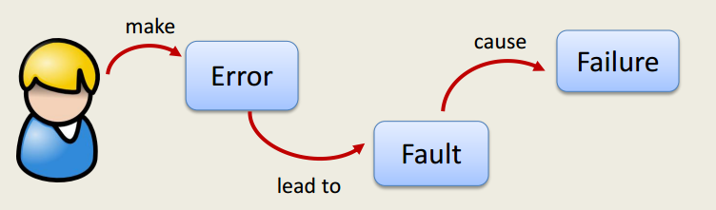
Definitions of V&V Terms
• Fault
Incorrect portions of code (may involve missing code as well as incorrect code)
Necessary (not sufficient) condition for the occurrence of a failure
• Failure: Observable incorrect behavior of a program.
• Error: Cause of a fault. something bad a programmer did (conceptual, typo, etc.)
• Bug: informal term for fault/failure.
Notes:
For example, I may accidentally assume a procedure is only called with a positive argument (the error).
So I forget to test for negative values (the fault).
Now if the procedure is actually called with a negative argument, something may go wrong (wrong answer, abortion): the failure
Note that the relation between errors, faults and failures need not be 1-1.

Slide 82
Example: error, fault, failure
For example, to assume a procedure is only called with a positive argument (the error).
Then tester might forget to test for negative values (the fault).
Now if the procedure is actually called with a negative argument, something may go wrong (wrong answer, abortion)- the failure
Note that the relation between errors, faults and failures need not be 1-1.
Notes:
For example, I may accidentally assume a procedure is only called with a positive argument (the error).
So I forget to test for negative values (the fault).
Now if the procedure is actually called with a negative argument, something may go wrong (wrong answer, abortion): the failure
Note that the relation between errors, faults and failures need not be 1-1.

Slide 83
A Concrete Example
Incorrect portions of code
Fault: Should start searching at 0, not 1
public static int numZero (int [ ] arr)
{ // Effects: If arr is null throw NullPointerException
// else return the number of occurrences of 0 in arr
int count = 0;
for (int i = 1; i < arr.length; i++)
{
if (arr [ i ] == 0)
{
count++;
}
}
return count;
}
Test 1
[ 2, 7, 0 ]
Expected: 1
Actual: 1
Something bad a programmer did
Error: i is 1, not 0, on the first iteration
Failure: none
Test 2
[ 0, 2, 7 ]
Expected: 1
Actual: 0
Error: i is 1, not 0
Error propagates to the variable count
Failure: count is 0 at the return statement
Observable incorrect behavior of a program

Slide 84
References
https://www.arbourgroup.com/blog/2015/verification-vs-validation-whats-the-difference/#:~:text=Validation%20is%20the%20process%20of,the%20producing%20high%20quality%20software.
https://www3.technologyevaluation.com/research/article/what-is-ivv-and-why-does-it-matter-to-software-selection.html

Slide 85
Questions ….

Slide 86
California State University, Sacramento Computer Science Department
CSC 179 : Software Testing and Quality Assurance
Summer 2022
Lecture # 3
Software Testing Process & Modeling
Modeling the Software and the Software Environment

Slide 87
Software Testing Process -Four Phases-
1. Modeling the software and the software environment.
2. Designing test cases.
3. Automating, executing, and evaluating test cases.
4. Measuring testing progress.

Slide 88
Modeling The Software
Test engineers need to understand not only the software, but also the environment in which it operates.
Models should be a depiction of the software’s behavior, which can be described in terms of the input sequences accepted by the system; the actions, conditions, and output logic; or the flow of data through the applications, modules, and routines.
Useful models typically possess properties that make test generation effortless and, frequently, automatable.

Slide 89
Modeling Techniques
Decision Tables – Tables used to show sets of conditions and the actions resulting from them
Finite State Machines – A computational model consisting of a finite number of states and transitions between those states, possibly with accompanying actions
State charts – Behavior diagrams specified as part of the Unified Modeling Language (UML). A state chart depicts the states that a system or component can assume and shows the events or circumstances that cause or result from a change from one state to another.

Slide 90
Modeling the Software Developing the Model & Exploring the System
Develops an in-depth understanding of the system's functionality.
This is accomplished by:
Using the application
Thoroughly examining the specification
Develop a model
90

Slide 91
Modeling the Software Understanding The System Under Test
Develop a “Behavioral Model ” – State Transition Diagram –
To understand the system under test ……
Identify all states and inputs
Form a state transition table
Form a state transition diagram
91

Slide 92
Understanding The System Under Test
Each input found is analyzed with two questions
When is the input available?
What happens after the input is applied?
92

Slide 93
Understanding The System Under Test
Light Switch Example –
Description: A simple light switch simulator
The following are the details -
The lights can be turned on and off using one input.
The intensity of the light can be adjusted using two inputs for decreasing and increasing the intensity.
There are three levels of light intensity: dim, normal, and bright. If the lights are bright, increasing the intensity should not affect the intensity.
The simulator starts with the lights off. Finally, when the lights are turned on, the intensity is normal by default, regardless of the intensity of the light when it was last turned off.
93

Slide 94
Understanding The System Under Test
Light Switch Example
“Light Switch” = (I, S, T, F, L), where:
I = {<turn on>, <turn off>, <increase intensity>, <decrease intensity>}
S = {[off], [dim], [normal], [bright]}
T:
<turn on> changes [off] to [normal]
<turn off> changes any of [dim], [normal], or [bright] to [off]
<increase intensity> changes [dim] to [normal], or [normal] to [bright]
<decrease intensity> changes [bright] to [normal], or [normal] to [dim]

Slide 95
Understanding The System Under Test
The inputs do not affect the state of the system under any condition not described above
F = [off]
L = [off]
95

Slide 96
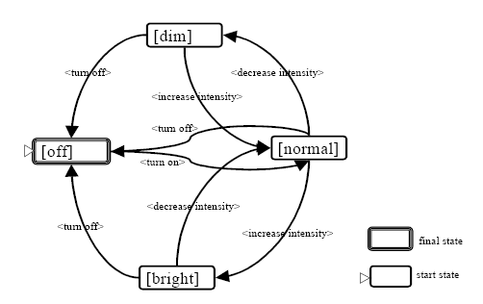
Light Switch Example - State Transition Diagram
96

Slide 97
Light Switch Example - State Transition Matrix
State\ Input | <turn on> | <turn off> | <increase intensity> | <decrease intensity>
[off] | [normal]
[dim] |  | [off] | [normal]
[normal] |  | [off] | [bright] | [dim]
[bright] |  | [off] |  | [normal]
97

Slide 98
Another Example State Transition Diagram - Reservation System
cancel()
[reservedSeats > 1]
reserve()
reserve()
NoReservation
entry/reset()
Partially-
Reserved
[FreeSeats > 1]
cancel()
[reservedSeats = 1]
reserve()
openFlight()
cancelFlight()
cancel()
[FreeSeats = 1]
close()
FullyBooked
Closed
close()

Slide 99
State Transition Diagram – Challenges
State Space Explosion: Number of states can be increased in a dramatical manner.
Solutions:
Abstraction: For example, a dialog box that requires the entry of multiple fields of data followed by the OK button, could be modeled as two abstract inputs: “enter valid data” and “enter invalid data.”
Exclusion: Simply dropping information without bothering to abstract it. This is mostly done when decomposing a set of software behaviors into multiple models.
Each model will contain certain inputs and exclude others. The inputs excluded by a modeler would have to be tested in some other way, obviously.

Slide 100
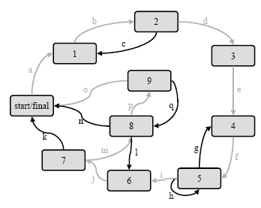
State Transition Diagram – Challenges
Meeting Coverage Criteria
For state machines, coverage is expressed in terms of inputs, states, and transitions.
For example, there is the criterion of covering all states.

Slide 101
Modeling The Software Use Case Model
Why The Use Case Model
Models how different actors interact with the system – simplifies communications and show interactions
Describes the goals of the users, the interactions between the users and the system
Captures the required behavior of the system in satisfying these goals.

Slide 102
Modeling The Software Use Case Model
Serves as a unifying thread throughout system development.
Used as the primary specification of the functional requirements for the system
Serves as the basis for analysis and design, as an input to iteration planning, as the basis of defining test cases
Captures the dynamic behavior of the system

Slide 103
Example BANKING APPLICATION
USE CASE Modeling
103

Slide 104
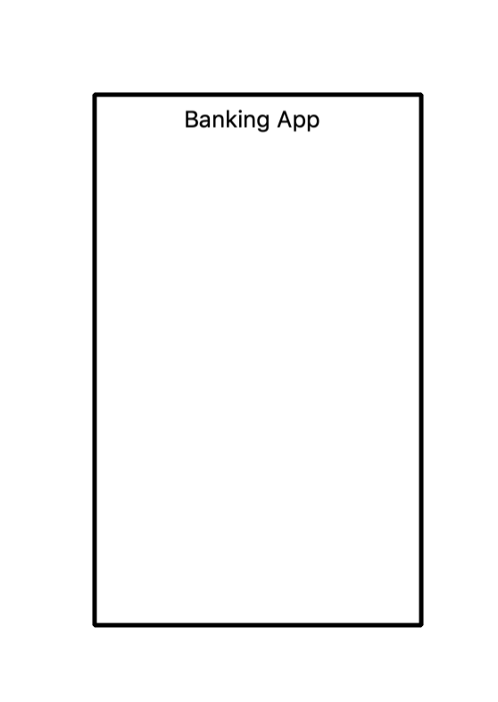
Identify the System
System = Banking App.
A system is represented by a rectangular box as below:
It helps to find scope of the system
Defines system boundaries
104

Slide 105
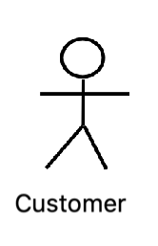
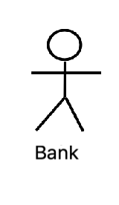
Identify Actors
A banking app is used by Customers, the Bank and other vendors
Actors are external so they are placed outside the System
Actors have generic name - Customer, Bank, etc.
Primary Actor = Customer ( initiates the actions)
Secondary Actor = Bank ( responds to actions)
105

Slide 106
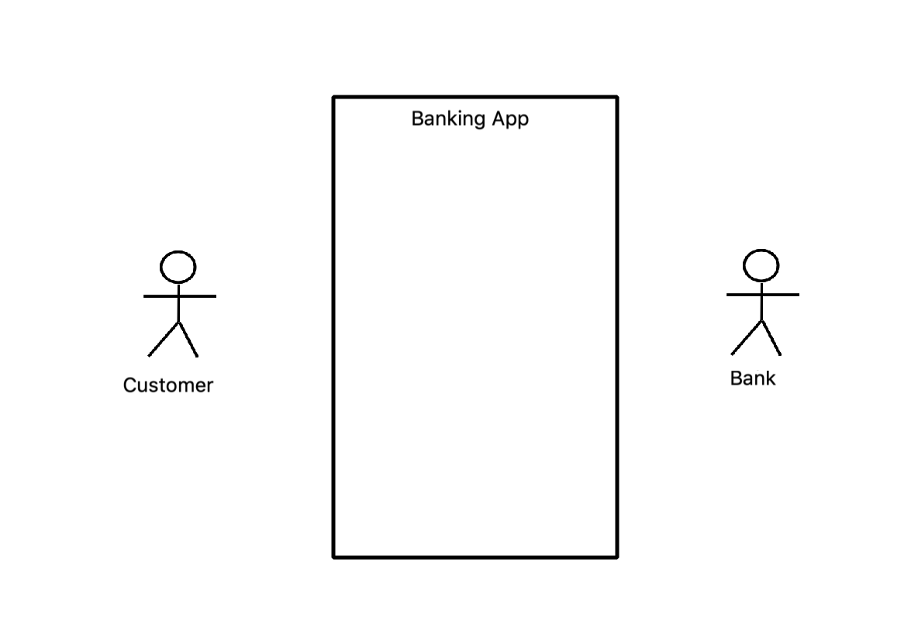
Place Actors
Primary actors are placed on the left of the System
Secondary actors are placed on the right of the System
106

Slide 107
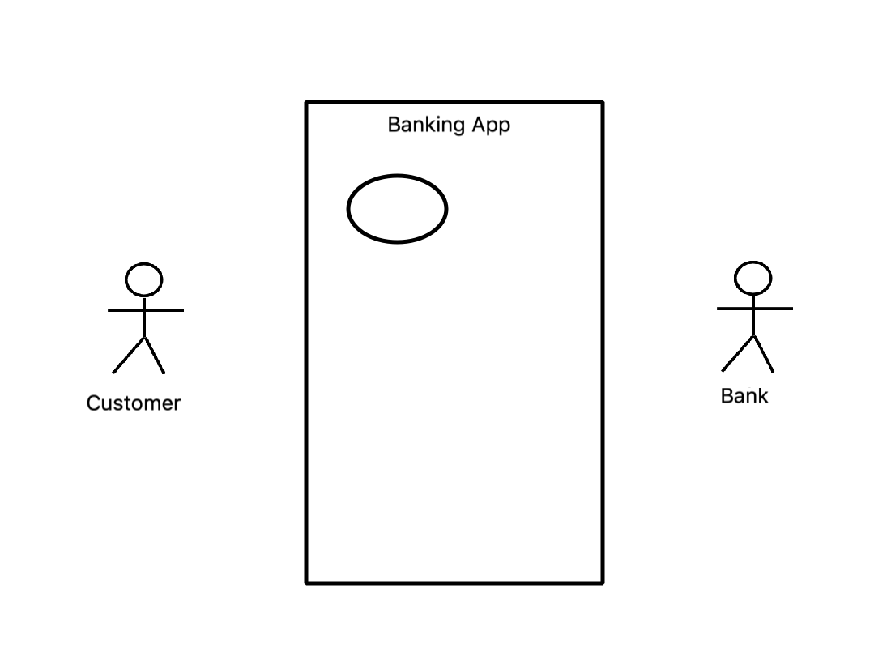
Use case
Use Case represents action that accomplishes actions or task in system.
107

Slide 108
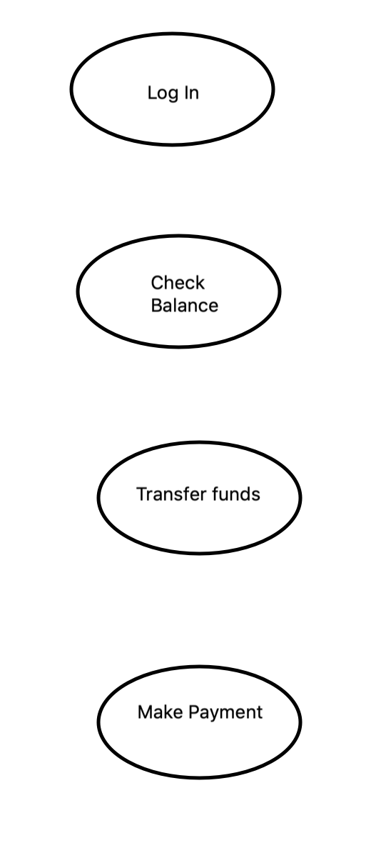
Identify Use cases
For banking app, the actions taken are Log In, checking balance, transferring funds and making payment.
Give descriptive name
Place in logical sequence
Represent these use cases as follows:
108

Slide 109
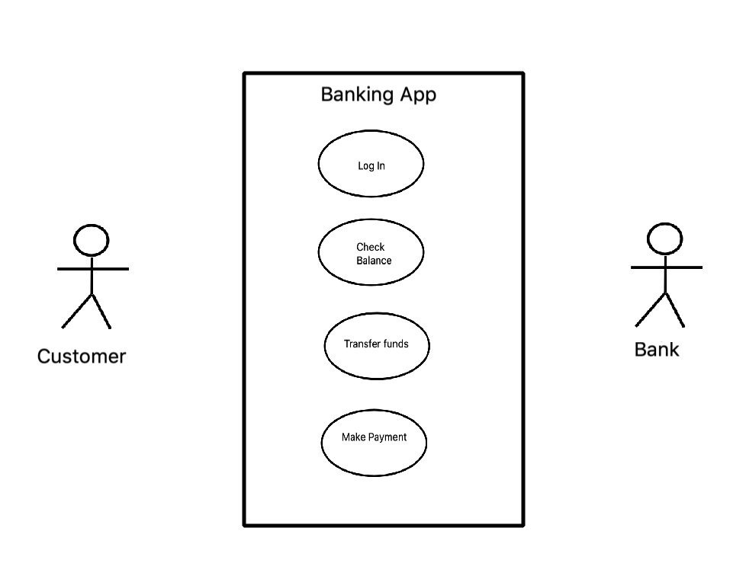
Include use cases in the System
Use cases occur within the System. Place the use cases inside the System
109

Slide 110
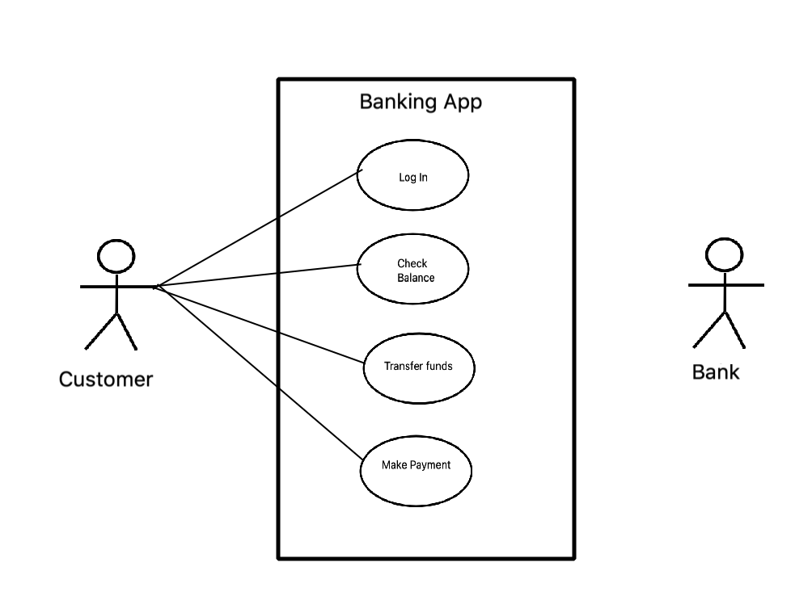
Establish Relationships- Primary Actor
Indicates communication and interactions of the Primary Actor with the System
Draw lines to indicate interactions
110

Slide 111
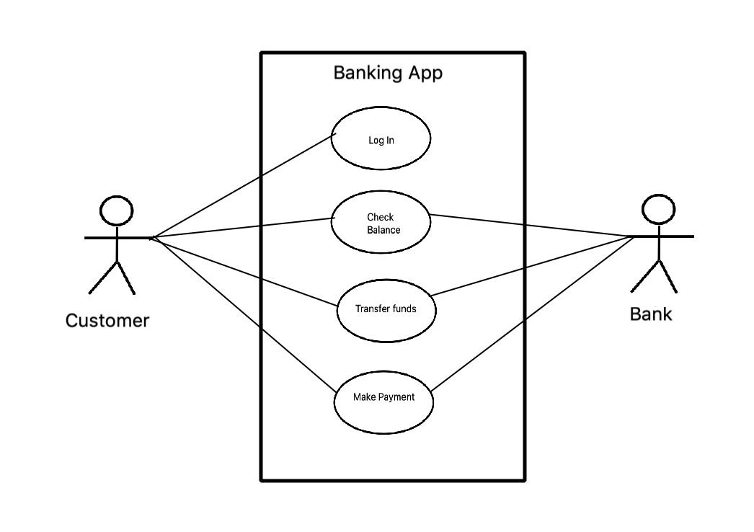
Establish Relationships - Secondary Actor
Indicates communication and interactions of Secondary Actor with the System
Draw lines to indicate interactions
Bank is not involved during Log In so no relationship with that use case
111

Slide 112
Include Extend Relationship
Some use cases extend the functionality of the base use cases and are depicted by Include/Extend relationship
112

Slide 113
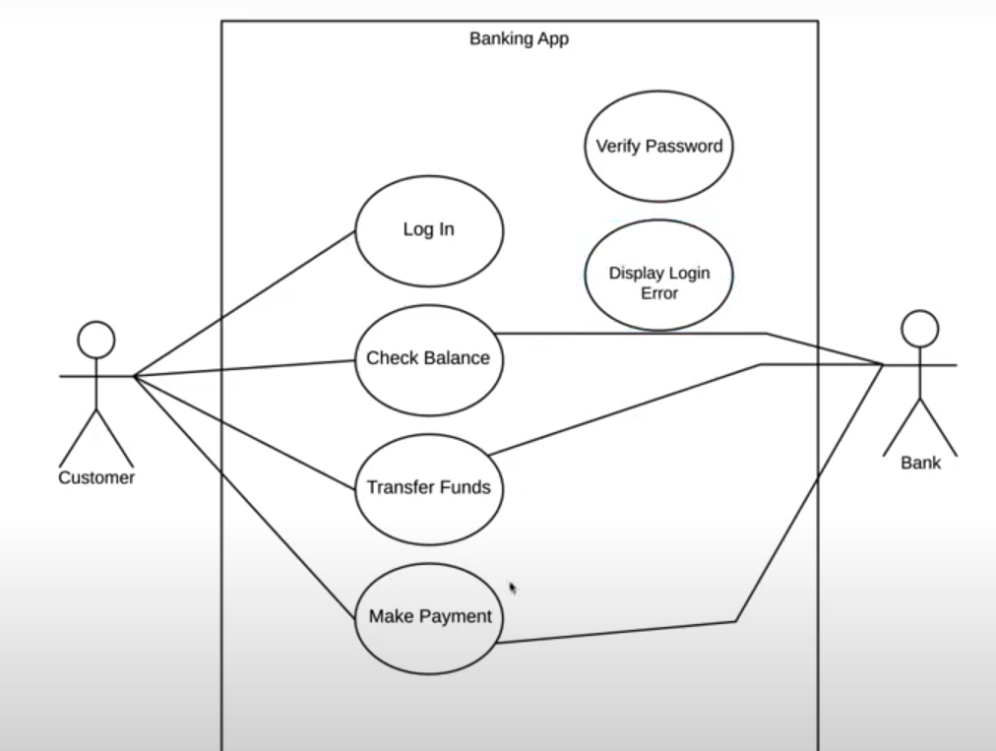
Include & Extend Relationships
Some use cases will have dependent actions.
Example:
1) After login we need to verify password
2) Unsuccessful login can result in Login Error.
113

Slide 114
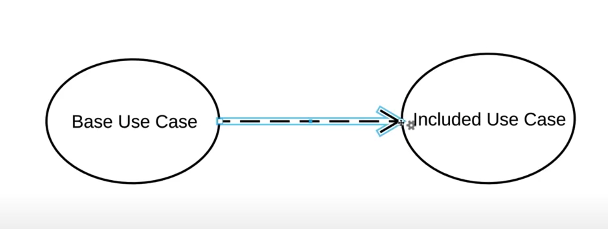
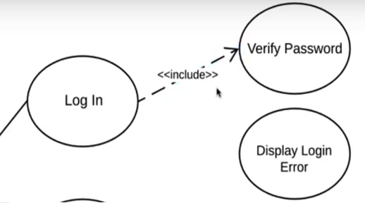
Include Relationships
Include Relationship:
After login we need to verify password
It is an action that must follow login, so it is an Include Relationship
Include is represented as follows
An Included Use Case must follow the Base Use Case
Base Use case not completed until Included use case has been completed
114

Slide 115
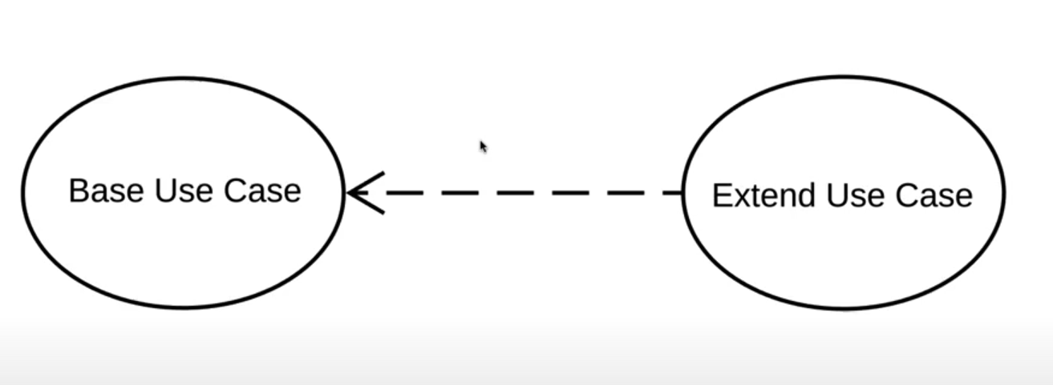
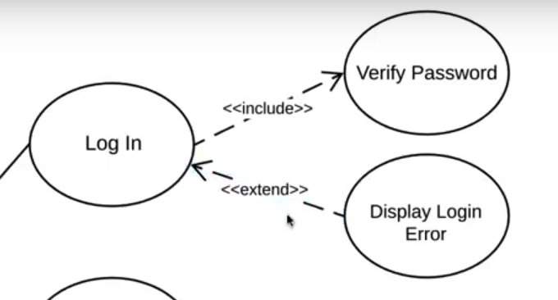
Exclude Relationships
Exclude Relationship
After login, due to incorrect credentials, an error page may be shown
It is an action that may follow login, so it is an Exclude Relationship
Exclude is represented as follows
An Excluded Use Case may happen due to some precondition following the Base Use Case
Base Use case not completed until Included use case has been completed
115

Slide 116
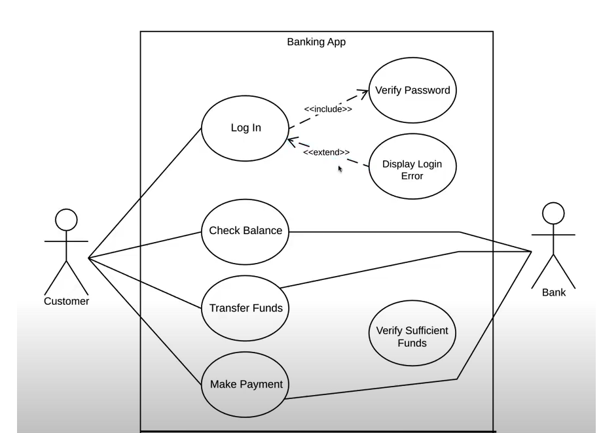
Use Case Diagram – Banking Application
116

Slide 117
Use Case – Another Example

Slide 118
Use Case Relationships
Supply
Order
Customer Data
Product
Arrange
Payment
«include»
«include»
«include»
«extend»
the salesperson asks for
Place
Order
the catalog
Request
Catalog

Slide 119
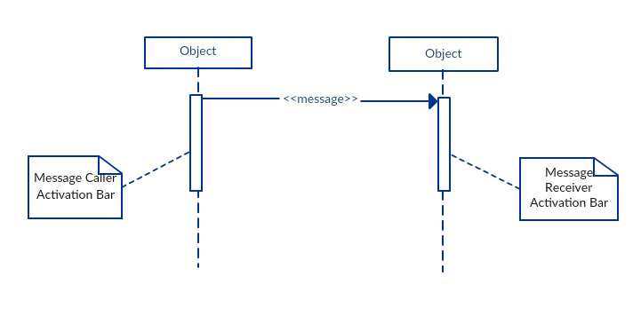
Sequence Diagrams
Sequence diagram is a type of interaction diagrams.
A sequence diagram emphasizes the time-ordering of messages;
119

Slide 120
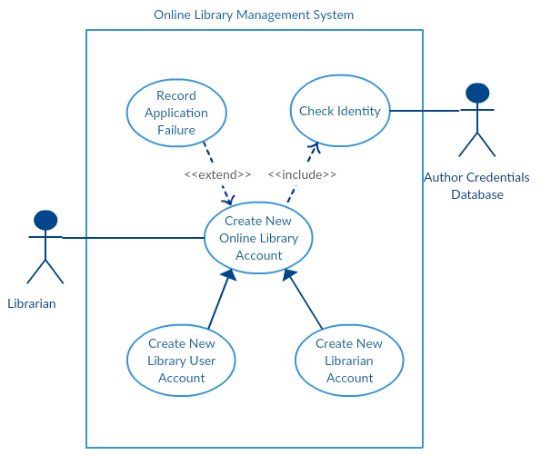
Use Case Model & Sequence Diagram

Slide 121
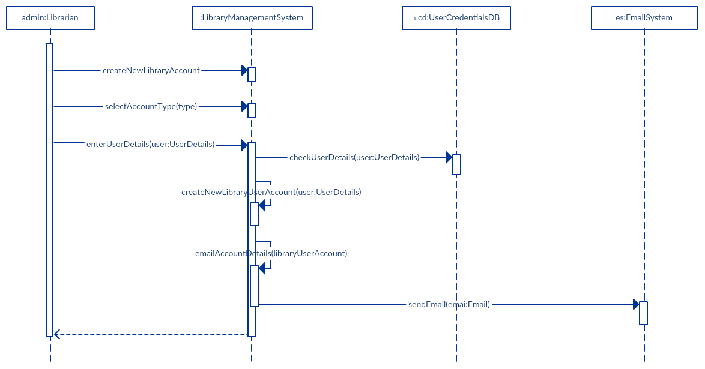
The sequence diagram to perform ‘Create New Library User Account’

Slide 122
Questions..?
122

Slide 123
CSC 179
Software Testing and Quality Assurance
Summer 2022
Lecture # 4
Verification & Validation Strategies

Slide 124
Purpose of a Test Strategy
Before developing test cases and test procedures to test a system, engineers should define:
The overall test strategy
To obtain consensus of goals and objectives from stakeholders (e.g., management, developers, testers, customers, users)
To manage expectations from the beginning. Identifies the types of tests to be conducted at all test levels

Slide 125
Test Case Design
Criteria-based
Human-based
Test cases are infinite
Only a subset is selected

Slide 126
Test Design – Criteria-Based
Design test values to satisfy coverage criteria or other engineering goals

Slide 127
Test Design – Human-Based
Design test values based on domain knowledge of the program and human knowledge of testing

Slide 128
Test Case Design Development of Test Cases
Test Case Design
Criteria-based: Design test values to satisfy coverage criteria or other engineering goal
Human-based: Design test values based on domain knowledge of the program and human knowledge of testing
How to select subset of test cases from all possible test cases with a high chance of detecting most faults ?
Define and implement test case design strategies
This is the most challenging task in software testing.

Slide 129
Test Case Design
Major objective is to design tests that systematically uncover types of defects with minimum and effectives set of test cases and minimum time and effort.
A good test case is one that has high probability of finding an undiscovered defect.
A successful test is one that uncovers an as-yet undiscovered defect.

Slide 130
Test Design Strategy
Any Engineered product can be tested (V&V) by two approaches /ways.
1. Knowing the specified functions product is designed to perform, test to demonstrate that each product is fully operational while exulting the product to discover defects (black Box)
Major focus: functions, operations, external interfaces, external data and information

Slide 131
Test Design Strategy
2. Knowing the internal workings of the product, test that the internal operations are performed according to specifications and that all internal components have been adequately tested and exercised.
Major focus: internal structures, logic paths, control flows, data flows, internal data structures, conditions, loops, etc.

Slide 132
Test Design Strategy
Black Box Testing
Knowing the specified functions product is designed to perform, test to demonstrate that each product is fully operational while exulting the product to discover defects (black Box)
From functional design specification
No internal knowledge of product needed
Does not test hidden functions

Slide 133
Black-Box Testing
Also called “Behavioral testing”
Because testing how the software actually behaves.
The testers only need to know that inputting A outputs B or that performing operation C results in D.
Then, defining the “test cases”.
Specific inputs and the procedures.

Slide 134
Equivalence Partitioning/Classes
One effective test case design technique is called “Equivalence Partitioning/Classes”
Equivalence partitioning is one way of selecting effective a subset of test cases.

Slide 135
Equivalence Partitioning/Classes
Basic Definitions:
The process of reducing the huge set of possible test cases into a much smaller, but still equally effective, set.
An equivalence partitioning is a set of test cases that tests the same thing or reveals the same bug.
Ways to group similar inputs, similar outputs, and similar operations of the software. These groups are your equivalence partitions.

Slide 136
Equivalence Partitioning/Classes
Divide all possible inputs into classes (partitions) such that:
There is a finite number of input equivalence classes.
system
Partitions/Classes
outputs
partition

Slide 137
Equivalence Partitioning/Classes
Equivalence partitioning:
- divide the input domain of a program into classes of data
- derive /design test cases based on these partitions.
Test case design for equivalence partitioning is based on an evaluation of equivalence classes for an input domain.
An equivalence class represents a set of valid or invalid states for input condition.
An input condition is:
- a specific numeric value, a range of values
- a set of related values, or a Boolean condition

Slide 138
Equivalence Partitioning/Classes Assumptions
You may reasonably assume that
the program behaves analogously for inputs in the same class
a test with a representative value from a class is sufficient
if representative detects fault then other class members will detect the same fault

Slide 139
Equivalence Partitioning/Classes
Equivalence partitioning may lead to the risk of eliminating test cases that might reveal bugs…..
It also can be subjective – Testers might arrive at two different sets of partitions…

Slide 140
Equivalence Partitioning/Classes
Strategy :
Identify input equivalence classes/partitions
Based on conditions on inputs / outputs in specification description
Both valid and invalid input equivalence classes
Based on heuristics and experience
“input x in [1..10]” → classes : x < 1, 1 ≤ x ≤ 10, x > 10
“enumeration A, B, C → classes : A, B, C, not{A,B,C,}
……..

Slide 141
Equivalence Partitioning/Classes
Define one / couple of test cases for each class
Test cases that cover valid equivalence classes
Test cases that cover at most one invalid equivalence class

Slide 142
Equivalence Partitioning/Classes
Test a function for calculation of absolute value of an integer
Equivalence classes :
Condition | Valid eq. classes | Invalid eq. Classes
nr of inputs | 1 | 0, > 1
Input type | integer | integer

Slide 143
Equivalence Partitioning/Classes
Example #1, Calculator’s Edit.
Five ways to perform “Copy” function.
Click Copy menu item.
Type c.
Type C.
Press Ctrl+c.
Press Ctrl+Shift+c.
Tester could partition these input paths down to three.
Clicking the command on the menu.
Typing a c.
Pressing Ctrl+c.

Slide 144
Equivalence Partitioning/Classes
Example #2, “Save As” dialog box.
Windows filename can contain any characters except \ / : * ? “ < > |.
Need equivalence partitions for
Valid characters
Invalid characters
Valid length names
Names that are too short
Names that are too long

Slide 145
Equivalence Partitioning/Classes
If the input specifies a range of valid values, define one valid partition (within the range) and two invalid partitions (one outside each end of range).
Example: If the input requires a month in the range of 1-12, define one valid partition within 1 and 12 and two invalid partitions (month<1 and month>12).

Slide 146
Equivalence Partitioning/Classes
If the input specifies the number (N) of valid values, define one valid partition and two invalid partitions (none, and more than N).
Example: If the input requires the titles of at least 3 books but no more than 8, then define one valid partition and two invalid partitions (<3 and >8 books).

Slide 147
Equivalence Partitioning/Classes
If the input specifies a “must be” situation, define one valid partition and one invalid partition.
Example: If the first character of the input must be numeric, then define one valid partition where the first character is a number and one invalid partition where the first character is not a number.

Slide 148
Black-box: Boundary Value Analysis
Based on experience / heuristics :
Testing boundary conditions of eq. classes is more effective i.e. values directly on, above, and beneath edges of eq. partitions / classes
Choose input boundary values as tests in input eq. partitions / classes instead of, or additional to arbitrary values
Choose also inputs that invoke output boundary values ( values on the boundary of output classes )

Slide 149
Boundary Value Analysis
Example strategy as extension of equivalence partitioning:
choose one (n) arbitrary value in each partition class
choose values exactly on lower and upper boundaries of Equivalence partition
choose values immediately below and above each boundary (if applicable )

Slide 150
Boundary Value Analysis (BVA)
A test case design technique -- complements to equivalence partition
Boundary value analysis leads to a selection of test cases that exercise bounding values.
If an input condition specifies a range bounded by values a and b,
Test cases should be designed with value a and b, just above and below a and b.
Example: Integer D with input condition [-3, 10],
test values: -3, 10, 11, -2, 0

Slide 151
Boundary Value Analysis (BVA)
If an input condition specifies a number values, test cases should be developed to exercise the minimum and maximum numbers. Values just above and below minimum and maximum are also tested.
Example: Enumerate data E with input condition: {3, 5, 100, 102}
test values: 3, 102, -1, 200, 5

Slide 152
Boundary Value Analysis
Guidelines 1 and 2 are applied to output condition.
If internal program data structures have prescribed boundaries, be certain to design a test case to exercise the data structure at its boundary
Such as data structures: - array
input condition:
empty, single element, full element, out-of-boundary
search for element:
element is inside array or the element is not inside array

Slide 153
Black-box: Error Guessing
Just ‘guess’ where the errors are ……
Intuition and experience of tester
Ad hoc, not really a technique
Strategy:
Make a list of possible errors or error-prone situations ( often related to boundary conditions)
Write test cases based on this list

Slide 154
Black-box: Error Guessing
More sophisticated ‘error guessing’ : Risk Analysis
Try to identify critical parts of program (high risk code sections):
parts with unclear specifications
complex code : measure code complexity –
High-risk code will be more thoroughly tested ( or be rewritten immediately ….)

Slide 155
Black-Box Testing: Which One ?
Black-box testing techniques :
Equivalence partitioning
Boundary value analysis
Error guessing
………
Which one to use ?
None is complete
All are based on some kind of heuristics
They are complementary

Slide 156
Black-Box Testing: Which One ?
Always use a combination of techniques
When a formal specification is available try to use it
Identify valid and invalid input equivalence partitions / classes
Identify output equivalence partitions / classes
Apply boundary value analysis on valid equivalence partitions / classes
Guess about possible errors

Slide 157
Questions …
More on Equivalence Partitions

Slide 158
California State University, Sacramento Computer Science Department
CSC 179 : Software Testing and Quality Assurance
Spring 2022
Lecture # 5
Black Box Testing
Decision Tables & Cause Effect Graphing

Slide 159
Decision Tables
It is based on system requirements.
DT are tables that list all possible “conditions” (inputs) and all possible actions (outputs).
It labor intensive for large systems.
Useful for describing critical component of the system. (e.g., payroll, insurance, authorization schedule, etc.)

Slide 160
Decision Tables
Applicable to the software requirements
Can be automatically translated into code
Assume the independence of inputs
Example
If c1 AND c2 OR c3 then A1

Slide 161
Decision Tables
Table # 1 contains a decision table for computing payroll taxes.
There is a “Rule” for each possible combination of conditions.
For each condition it is identified as a “Yes”, a “NO”, or an “I” for immaterial

Slide 162
Table # 1
Conditions | R1 | R2 | R3 | R4
Wages Earned | N | Y | Y | Y
End of Pay Period | I | N | Y | Y
FICA Salary Exceeded | I | I | N | Y
ACTIONS
Withhold FICA Tax | N | N | Y | N
Withhold Medicare Tax | N | N | Y | Y
Withhold Payroll Tax | N | N | Y | Y

Slide 163
Table # 1 Description
To read the table go to the first (top) condition and follow the row to the right until the rule that satisfies the condition is met.
Then go to each succeeding rule and follow the column down until the corresponding condition is satisfied.
When the last condition is satisfied, apply the actions indicted by column (rule) that you ended up in.

Slide 164
Table # 1 Description
For example, if the answer to wages Earned is “Y”, we go to Rule 2,3,or 4 .
If the answer to the condition End of Pay Period is “Y”. Then we now go to rule 3 or 4.
If the FICAS Salary Exceeds condition is “Y” then we flow the table down R 4 to the actions and know that we must:
Not withhold FICA Tax
Withhold Medicare Tax
Withhold Payroll Tax

Slide 165
Input Conditions for Test Cases & Expected Results
Test case | Input Condition | Expected Results
1 | No wages Earned | Don’t Withhold FICA Tax Don’t Withhold Medicare Don’t Withhold Payroll Tax
2 | Wages Earned Not End of Pay Period | Don’t Withhold FICA Tax Don't Withhold Medicare Don't Withhold Payroll Tax
3 | Wages Earned End of Pay Period FICA Not Exceeded | Withhold FICA Tax Withhold Medicare Withhold Payroll Tax
4 | Wages Earned End of Pay Period FICA Salary Exceeded | Don’t Withhold FICA Tax Withhold Medicare Withhold Payroll Tax

Slide 166
Cause - Effect Graphing
Cause-Effect Graphing technique derives the minimum number of test cases to cover 100% of the functional requirements to improve the quality of test coverage.

Slide 167
Cause - Effect Graphing – Basics
Invented by Bill Elmendorf of IBM in 1973.
Uses same algorithms that are used in hardware logic circuit testing.

Slide 168
Cause - Effect Graphing – Why Helpful
Test case designer models problem using a cause-effect graph, instead of trying to manually determine the right set of test cases.
Cause-Effect Graphing also has the ability to detect defects that cancel each other out, and the ability to detect defects hidden by other things going right.

Slide 169
Intro to Cause - Effect Graphing – How To
Starts with the requirements document (reviewed for ambiguity).
Each cause (input) in the requirements is expressed in the cause-effect graph as a condition, which is either true or false.
Each effect (output) is expressed as a condition, which is either true or false.

Slide 170
Intro to Cause - Effect Graphing – How To (cont.)
Requirement: “If A OR B, then C.”
If A is true and B is true, then C is true.
If A is true and B is false, then C is true.
If A is false and B is true, then C is true.
If A is false and B is false, then C is false.

Slide 171
Intro to Cause - Effect Graphing – How To (cont.)
Node
Leads to --------------
V OR
Λ AND
~ NOT

Slide 172
Intro to Cause - Effect Graphing – How To (cont.)
Cause-Effect Graph
A
V C
B

Slide 173
Intro to Cause - Effect Graphing – How To (cont.)
Decision Table
Causes :
A
B
Effects :
C
T 1
T
F
T
T 2
F
T
T
T 3
F
F
F

Slide 174
Cause - Effect Example
The Requirements
Postal Regulations: Country and Weight charges for Parcels
Argentina All Weights $11
Brazil Weight > 33 pounds $21
Brazil Weight = 33 pounds $19
Brazil Weight < 33 pounds $17

Slide 175
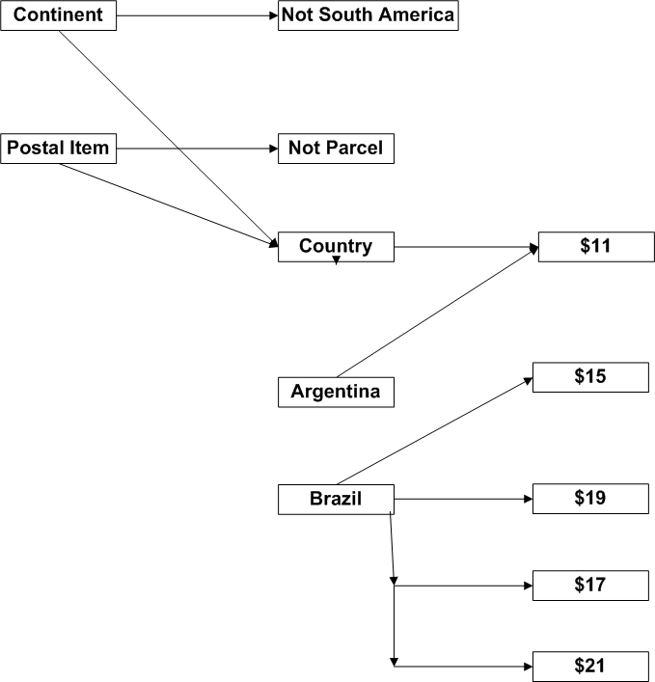
175

Slide 176
Test Cases
Test#1
Cause: Item sent to Asia
Effect: Out of scope
Test #2
Cause:
Item sent to South America
Item is NOT a parcel
Effect: Out of scope

Slide 177
More Test Cases
Test #3
Cause:
Item sent to South America
Item is a parcel
Country is Argentina
Effect: $11

Slide 178
More Test Cases (Cont.)
Test #4
Cause:
Item sent to South America
Item is parcel
Country is Brazil
Weight > 33 pounds
Effect: $21

Slide 179
Points to Keep In Mind
Requirements Based Testing is the first phase of testing
Cause Effect Graphing provides consistent approach to deriving test cases
Determines minimum number of test cases
Test effort minimized and complete

Slide 180
California State University, Sacramento Computer Science Department
Summer 2022
Lecture # 6
CSC 179 : Software Testing and Quality Assurance
V & V and Software Testing Strategies
White Box & Static Testing

Slide 181
Test Design Strategy
Knowing the internal workings of the product, test that the internal operations are performed according to specifications and that all internal components have been adequately tested and exercised.
Major focus: internal structures, logic paths, control flows, data flows, internal data structures, conditions, loops, etc.
“White Box Testing”

Slide 182
White Box Purpose
Encompasses four areas:
Directly testing low-level functions, procedures, subroutines, or libraries.
Testing the software at the top level, as a completed program.
Gaining access to read variables and state information and being able to force the software to do things that would be difficult if you tested it normally.
Measuring how much of the code and what code you “hit” and then adjusting your testing.

Slide 183
White Box Testing
Here we examine the code and ensure that our test cases exercise all the program code.
Obviously, untested code may contain the most severe errors.
There may be unusual conditions that can arise in the program, but do not occur with any of the black-box test cases. Test cases should be built to cause these conditions to arise as well.
We should also ensure that our test cases cause all possible execution paths to be exercised as well.

Slide 184
White Box Methods
Statement Coverage:
This measure reports whether each executable statement is encountered.
The main disadvantage of statement coverage is that it is insensitive to some control structures.
Without a test case that causes condition to evaluate false, statement coverage might rate code to be fully covered.

Slide 185
Statement Coverage
Statement coverage does not report whether loops reach their termination condition - only whether the loop body was executed.
With C, C++, and Java, this limitation affects loops that contain break statements.
Statement coverage is completely insensitive to the logical operators (|| and &&).
Statement coverage cannot distinguish consecutive switch labels.

Slide 186
Decision Coverage
This measure reports whether boolean expressions tested in control structures
such as the if-statement and while-statement evaluated to both true and false.
This measure has the advantage of simplicity without the problems of statement coverage.
A disadvantage is that this measure ignores branches within boolean expressions which occur due to short-circuit operators.

Slide 187
Decision Coverage
For example, C/C++/Java code fragment:
if (condition1 && (condition2 || function1()))
statement1;
else
statement2;
This measure could consider the control structure completely exercised without a call to function1.
The test expression is true when condition1 is true and condition2 is true, and the test expression is false when condition1 is false.
In this instance, the short-circuit operators preclude a call to function1.

Slide 188
Condition Coverage
Condition coverage reports the true or false outcome of each Boolean sub-expression, separated by logical-and and logical-or if they occur.
Condition coverage measures the sub-expressions independently of each other.
This measure is like decision coverage but has better sensitivity to the control flow.
However, full condition coverage does not guarantee full decision coverage.

Slide 189
Condition Coverage
For example, consider the following C++/Java fragment.
bool f(bool e) { return false; }
bool a[2] = { false, false };
if (f(a && b)) ...
if (a[int(a && b)]) ...
if ((a && b) ? false : false) ...
All three of the if-statements above branch false regardless of the values of a and b.
However if you exercise this code with a and b having all possible combinations of values, condition coverage reports full coverage.

Slide 190
Path Testing
Execute every possible path of a program, i.e., every possible sequence of statements
Strongest white-box criterion
Usually impossible: infinitely many paths
( in case of loops )

Slide 191
Code Coverage
Testing the data is only part of it.
Attempt to enter and exit every module, execute every line of code, and follow every logic and decision path through the software.
Simplest form is
Using compiler’s debugger to view the lines of code as single-step through the problem.

Slide 192
Code Coverage (cont.)
Use code-coverage analyzer
These analyzers:
Linked to the software under test.
Run transparently in the background.
Record the information during testing.
Provide statistics that identify which portions were executed and which weren’t.

Slide 193
Code Coverage (cont.)
With the analyzer’s information, test engineers can know the following:
What parts of the software the test cases did not cover.
Which test cases are redundant.
What new test cases need to be created for better coverage.

Slide 194
Coverage Goal for Release
Each project must choose a minimum percent coverage for release criteria based on available testing resources and the importance of preventing post-release failures.
Safety-critical software should have a higher goal.
Test engineers might set a higher coverage goal for unit testing than for system testing since a failure in lower-level code may affect multiple high-level callers.

Slide 195
Test Coverage
Using statement coverage, decision coverage, or condition coverage Test engineers generally want to attain 80%-90% coverage or more before releasing.
Some testers feel that setting any goal less than 100% coverage does not assure quality.
Avoid setting a goal lower than 80%.

Slide 196
Advantages & Disadvantages of White Box
As the knowledge of internal coding structure is prerequisite, it becomes very easy to find out which type of input/data can help in testing the application effectively.
It helps in optimizing the code.
It helps in removing the extra lines of code, which can bring in hidden defects.
As knowledge of code and internal structure is a prerequisite, a skilled tester is needed to carry out this type of testing, which increases the cost.
It is nearly impossible to look into every bit of code to find out hidden errors…

Slide 197
White Box Testing - How to Apply It?
Start with black-box test cases (equivalence partitioning, boundary value analysis, Cause Effect Graphing, Decision Tables, etc.)
Check white-box coverage ( statement-, branch-, condition , path)
Use a coverage tool
Design additional white-box test cases for not covered code

Slide 198
Static Testing
Verification – is a “human” examination or review of the work product
Inspections
Walkthroughs
Buddy checks

Slide 199
Formal Structured Types
Inspections are the most structured form of verification
Key elements:
Everyone within review group participates
A written report is produced
Review group is responsible for quality of report

Slide 200
Inspection: Key Elements and Phases
Objectives:
To obtain defects and collect data;
To communicate important work product information
Elements:
A planned, structured meeting with preparation by all individual participants
A team of 3-6 people, led by impartial moderator
Presenter is “reader” other than the producer

Slide 201
Inspection
Input:
Document to be inspected
Related source documents
General and “tailored” checklists.
Output:
Inspection summary/report
Data on error types

Slide 202
Walkthroughs
Less formal than inspection
Lack of preparation
Prepared only by the presenter
No participation prior to meeting by participants
Cover more material than inspections

Slide 203
Walkthroughs: Key Elements
Objective:
To detect defects and to become familiar with the material
Elements:
A planned meeting where only the presenter must prepare
A team of 2-7 people, led by the producer/author

Slide 204
Walkthroughs: Key Elements
The presenter is usually the producer
Input:
Element under examination, objectives for the walkthrough, applicable standards
Output:
report

Slide 205
Buddy Checks
For material that cannot be formally inspected or reviewed
Have someone else take a close look to find defects that yourself did not see
Can be efficient and used for training and finding errors in products

Slide 206
Checklists: The Verification Tool
Requirements Verification Checklist
Functional Design Verification Checklist
Internal Design Verification Checklist
Generic Code Verification Checklist
Code Verification Checklist
Generic Document Verification Checklist

Slide 207
Development and Testing Checklists
Testing checklists tend to be oriented toward reliability and usability of the product.
Developments checklists are usually more focused on maintainability and guidelines for coding standards.
Develop your checklists within your organization
These checklists reflects the present level of maturity in verification testing

Slide 208
Verifying Documents at Different Phases
Verifying Requirements:
Make sure user needs are properly understood
Avoid making changes to requirements
Explicit and implicit requirements
Compose a formal document

Slide 209
Verifying the Functional Design
Process of translating user requirements into external (human) interfaces
Matches user requirements to functional design
One of the most common failings of functional design specification is incompleteness.
The question that need to be asked frequently is “What is Missing?”

Slide 210
Verifying the Internal Design
Process of translating functional design into data structures, data flows, and algorithms
Determines how product will be built
Require internal-based tests
Tracing the path back to functional design and back to requirements is essential

Slide 211
Verifying the Code
Process of translating detailed design into sets of code
Comparing the code with internal design specifications
Use static analysis tool to check for compliance with syntactic/content requirements
Searching for new limitations that can form a basis for validation test.

Slide 212
Obtaining Standards
American National Institute (ANSI), www.ansi.org
International Engineering Consortium (IEC), www.iec.org
International Organization for Standardization (ISO), www.iso.ch
National Committee for Information Technology Standards (NCITS), www.ncits.org
Association for Computing Machinery (ACM), www.acm.org
Institute of Electrical and Electronics Engineers, Inc (IEEE), www.ieee.org

Slide 213
Generic Code Review Checklist
Comparing the code against a standard or a guideline.
Making sure that the code meets the project’s design requirements.

Slide 214
Data Reference Errors
Bugs caused by using a variable, constant, array, string, or record that hasn’t been properly initialized.
Is an uninitialized variable referenced?
Are array and string subscripts integer values and are they always within the bounds of the array’s or string’s dimension?
Is a variable used where a constant would actually work better?
…

Slide 215
Computation Errors
The calculation don’t result in the expected result.
Do any calculations that use variables have different data type, such as adding an integer to a floating-point number?
Do any calculations that use variables have the same data type but are different lengths?
Are the compiler’s conversion rules for variables of inconsistent type or length understood and considered in any calculations?
…

Slide 216
Comparison Errors
Less than, greater than, equal, not equal, true, false.
Comparison and decision errors are very susceptible to boundary condition problems.
Are the comparison correct?
Does each Boolean expression state what it should state?
Dose the Boolean calculation work as expected.

Slide 217
Control Flow Errors
Loops and other control constructs not behaving as expected.
If the language contains statement groups such as begin…end and do…while, are the ends explicit and do they match their appropriate group.
Will the program, module, subroutine, or loop eventually terminate?
Is there possibility of premature loop exit.
…

Slide 218
Subroutine Parameter Errors
Incorrect passing of data to and from software subroutine.
Do the types and sizes of parameters received by a subroutine match those sent by the calling code?
If a subroutine has multiple entry points , is a parameter ever referenced that isn’t associated with the current point of entry?
If constants are ever passed as arguments, are they accidentally changed in the subroutine?

Slide 219
Input/Output Errors
Reading from a file, accepting input from a keyboard or mouse, writing to a printer or screen…
Does the software strictly adhere to the specified format of the data being read or written by the external device?
If the file or peripheral isn’t present or ready, is that error condition handled?
Are all conceivable errors handled by the software in an expected way?
…

Slide 220
Three Critical Success Factors
Success Factor 1: Process Ownership
A champion to take full responsibility of a process
Work long term on process to gain support for it
Success Factor 2: Management Support
Initiate the adoption of inspection
Managers should be well briefed on inspections and its benefits

Slide 221
Success Factor 3: Training
Specific training for practitioners on how to perform reviews and inspections
The use of real work products from the local environment for training
All inspectors should be trained

Slide 222
Questions?

Slide 223
California State University, Sacramento Computer Science Department
CSC 179 : Software Testing and Quality Assurance
Summer 2022
Lecture # 7
White Box Testing
Path Testing

Slide 224
Software Testing – The Challenge
Testing can only show the presence of failures…
…not their absence

Slide 225
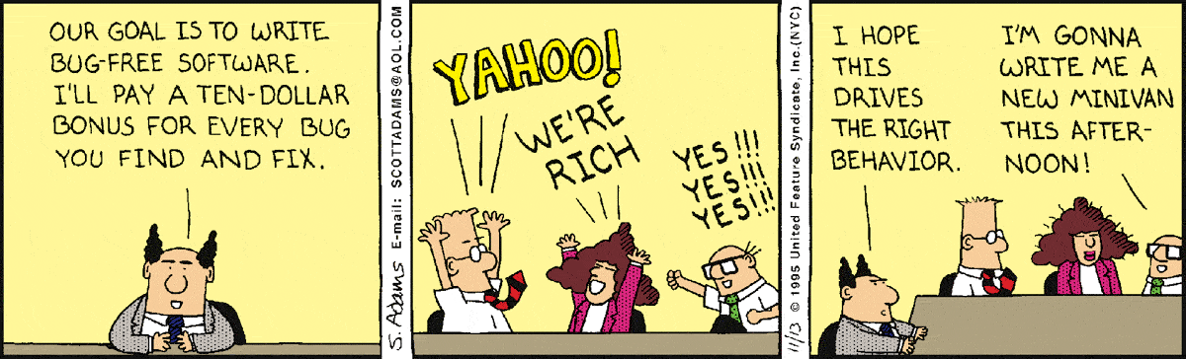
Driving Testing Behavior

Slide 226
Testing Levels
main()
class A
class B
method mA1()
method mB1()
method mA2()
method mB2()

Slide 227
Testing Levels
main()
class A
class B
method mA1()
method mB1()
method mB1()
method mA2()
method mB2()
method mB2()
Unit testing: test each unit (method) individually

Slide 228
Testing Levels
main()
class A
class B
method mA1()
method mB1()
method mB1()
Module testing: test each class, file, module, component
method mA2()
method mB2()
method mB2()
Unit testing: test each unit (method) individually

Slide 229
Testing Levels
main()
class A
class B
Integration testing: test how modules interact
method mA1()
method mB1()
method mB1()
Module testing: test each class, file, module, component
method mA2()
method mB2()
method mB2()
Unit testing: test each unit (method) individually

Slide 230
Testing Levels
main()
System testing: test the overall functionality of the system
class A
class B
Integration testing: test how modules interact
method mA1()
method mB1()
Module testing: test each class, file, module, component
method mA2()
method mB2()
Unit testing: test each unit (method) individually

Slide 231
Testing Levels
Acceptance testing: is the software acceptable to the user?
main()
System testing: test the overall functionality of the system
class A
class B
Integration testing: test how modules interact
method mA1()
method mB1()
Module testing: test each class, file, module, component
method mA2()
method mB2()
Unit testing: test each unit (method) individually

Slide 232
V Model of System Development
Requirements
Acceptance Test
Architectural Design
System Test
Subsystem Design
Integration Test
System Development
System Verification
Detailed Design
Module Test
Implementation
Unit Test

Slide 233
Path Testing
Path testing is a structural testing method
It uses the source code to find every possible executable path.
It enable testers to find faults within the source code.
It designed to execute all or selected path with segment of code.
11

Slide 234
Path Testing
It is the primary unit test technique
Preferred by software development and test engineers
Proven to be highly effective in identifying the independent paths and the hidden coding defects and issues in a source code.
Its objectives to eliminate testing redundancy and accuracy in finding hidden coding defects make it so simple yet inventive.
12

Slide 235
Basis Path Testing
However, the software under test includes many entry and exit points.
Testing each of these points is very challenging and time-consuming.
To reduce redundancy (reduce the redundant test cases) and achieve maximum test coverage, basis path testing is used.
13

Slide 236
Basis Path Testing
It is a White Box Testing method in which test cases are defined based on flows or logical paths that can be taken through the program.
Objectives:
Enables the test case designer to derive a logical complexity measure of the design
To define the number of independent paths and to maximize test coverage.
14

Slide 237
Basis Path Testing Steps
1. Create /draw a control flow graph (to determine different program paths)
2. Calculate Cyclomatic complexity (metrics to determine the number of independent paths)
3. Find a basis set of paths
4. Generate test cases to exercise each path
15

Slide 238
Create Control Flow Graph Flow Graph
1 int functionY(void)
2 {
3 int x = 0;
4 int y = 19;
5 A: x++;
6 if (x > 999)
7 goto D;
8 if (x % 11 == 0)
9 goto B;
10 else goto A;
11 B: if (x % y == 0)
12 goto C;
13 else goto A;
14 C: printf("%d\n", x);
15 goto A;
16 D: printf("End of list\n");
17 return 0;
18 }
3
4
5
6
8
7
10
9
16
11
17
13
12
14
15

Slide 239
Create Control Flow Graph
Arrows called edges indicates flow of control.
Circles called nodes indicates one or more actions.
Areas bounded by edges and nodes are called regions.
A predicate node is a node containing a condition.
17

Slide 240
Flow Graph Notations
A circle in a graph represents a node, which stands for a sequence of one or more procedural statements
A node containing a simple conditional expression is referred to as a predicate node
Each compound condition in a conditional expression containing one or more Boolean operators (e.g., and, or) is represented by a separate predicate node
A predicate node has two edges leading out from it (True and False)

Slide 241
Flow Graph Notation
An edge, or a link, is an arrow representing flow of control in a specific direction
An edge must start and terminate at a node
An edge does not intersect or cross over another edge
Areas bounded by a set of edges and nodes are called regions
When counting regions, include the area outside the graph as a region, too
19

Slide 242
Cyclomatic Complexity
Software engineers and test engineers always aim for code that is easy to test, easy to understand and modify. (testable code)
The question always “ How do we know that the code is testable
One answer is that make it short as short code is always good.
But that might not be sufficient – we need a better metric
Cyclomatic complexity is a valuable metric to measure the complexity of code. It is computed using the control flow graph of the code.
20

Slide 243
Cyclomatic Complexity
Quantitative software metric to determine the number of independent paths as well as the complexity of the program.
It is also a source code complexity unit that is corresponded to diverse coding errors.
It is computed by generating a control-flow graph of the codes measuring the linearly independent paths.
21

Slide 244
Cyclomatic Complexity
Provides a quantitative measure of the logical complexity of a program
Defines the number of independent paths in the basis set
Provides an upper bound for the number of tests that must be conducted to ensure all statements have been executed at least once

Slide 245
Cyclomatic Complexity
Can be computed three ways
The number of regions
= E – N + 2, where E is the number of edges and N is the number of nodes in graph G
= P + 1, where P is the number of predicate nodes in the flow graph G
23

Slide 246
Deriving the Paths and Test Cases
Using the design or code as a foundation, draw a corresponding flow graph
Determine the cyclomatic complexity of the resultant flow graph
Determine the independent paths
Prepare test cases that will force execution of each path in the basis set

Slide 247
FLOW GRAPH EXAMPLE

Slide 248
1 int functionY(void)
2 {
3 int x = 0;
4 int y = 19;
5 A: x++;
6 if (x > 999)
7 goto D;
8 if (x % 11 == 0)
9 goto B;
10 else goto A;
11 B: if (x % y == 0)
12 goto C;
13 else goto A;
14 C: printf("%d\n", x);
15 goto A;
16 D: printf("End of list\n");
17 return 0;
18 }
3
4
5
6
8
7
10
9
16
11
17
13
12
14
15

Slide 249
A Sample Function to Diagram and Analyze

Slide 250
1 int functionZ(int y)
2 {
3 int x = 0;
4 while (x <= (y * y))
5 {
6 if ((x % 11 == 0) &&
7 (x % y == 0))
8 {
9 printf(“%d”, x);
10 x++;
11 } // End if
12 else if ((x % 7 == 0) ||
13 (x % y == 1))
14 {
15 printf(“%d”, y);
16 x = x + 2;
} // End else
18 printf(“\n”);
19 } // End while
20 printf("End of list\n");
21 return 0;
22 } // End functionZ
3
4
6
7
9
12
13
10
15
16
18
20
21

Slide 251
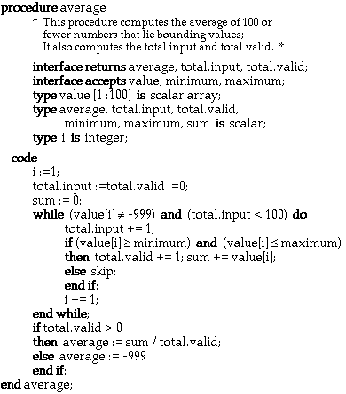
Deriving Test Cases: An Example
251

Slide 252
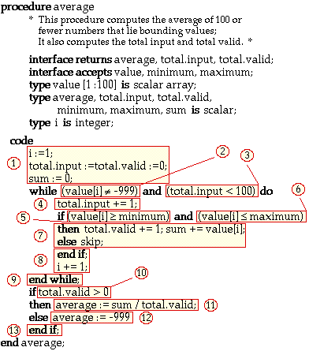
Deriving Test Cases: Identify Flow
252

Slide 253
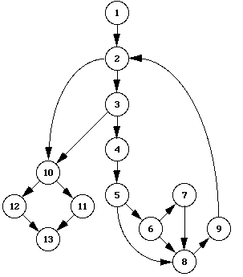
Deriving Test Cases: Draw Flow Graph
253

Slide 254
Deriving Test Cases: Determine Cyclomatic Complexity
=> V(G) = 6
17 edges - 13 nodes + 2 = 6
5 predicate nodes + 1 = 6
254

Slide 255
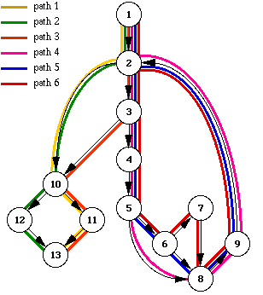
Deriving Test Cases: Determine A set of Linearly Independent Paths
255

Slide 256
Deriving Test Cases: Determine A set of independent Paths
path 1: 1 - 2 - 10 - 11 - 13
path 2: 1 - 2 - 10 - 12 - 13
path 3: 1 - 2 - 3 - 10 - 11 - 13
path 4: 1 - 2 - 3 - 4 - 5 - 8 - 9 - 2 - ...
path 5: 1 - 2 - 3 - 4 - 5 - 6 - 8 - 9 - 2 - ...
path 6: 1 - 2 - 3 - 4 - 5 - 6 - 7 - 8 - 9 - 2 - ...
256

Slide 257
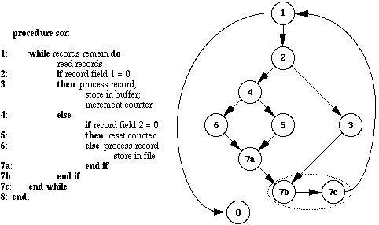
Another Example ….
257

Slide 258
Cyclomatic Complexity
E-N+2 = 4
Four paths to test …
1,8
1,2,3,7b,1,8
1,2,4,5,7a,7b,1,8
1,2,4,6,7a,7b,1,8
258

Slide 259
Example – Create the Model
Software Artifact
/**
* Return index of node n at the
* first position it appears,
* -1 if it is not present
*/
public int indexOf (Object o)
{
for (int i=0; i < list.size(); i++)
if (list.get(i).equals(o))
return i;
return -1;
}
Control Flow Graph
1
i=0
2
i<list.size()
return -1
3
4
if (…)
return i
5
6
i++

Slide 260
Example – Create the Model
Control Flow Graph
Initial Node: 1
Final Nodes: 3, 5
Edges:
(1, 2)
(2, 3)
(2, 4)
(4, 5)
(4, 6)
(6, 2)
1
i=0
2
i<list.size()
return -1
3
4
if (…)
return i
5
6
i++
Support tool for graph coverage:
http://www.cs.gmu.edu/~offutt/softwaretest

Slide 261
Example – Test Reqs and Specs
Control Flow Graph
Six requirements for edge coverage:
(1, 2)
(2, 3)
(2, 4)
(4, 5)
(4, 6)
(6, 2)
Test paths:
[1, 2, 3]
[1, 2, 4, 6, 2, 4, 5]
1
i=0
2
i<list.size()
return -1
3
4
if (…)
return i
5
6
i++
Next we need to find values to execute those test paths

Slide 262
Example – Input Values
Control Flow Graph
Test path [1, 2, 3]
list = { }
o = null
Test path [1, 2, 4, 6, 2, 4, 5]
list = { 1, 2 }
o = 2
1
i=0
2
i<list.size()
return -1
3
4
if (…)
return i
5
6
i++
We’ll talk about test implementation in future classes

Slide 263
Tools - Static Analysis
Unified Code Counter (UCC) produced by the Center for Systems and Software Engineering at the University of Southern California, are freely available.
Commercial tools such as Scientific Toolworks’ Understand, can also be used …
263

Slide 264
Tools - Static Analysis
Atlasean’s Bambo measure and display cyclomatic complexity for utilization by software developers, testers, and quality assurance analysts.
264

Slide 265
Tools - Static Analysis
OCLint – Static code analyzer for C
Reflector Add In – Code metrics for .NET
GMetrics – Find metrics in Java related applications
265

Slide 266
Benefits of Basis Path Testing
For both software developers and testers
Provides better and greater coverage
Validates other white-box tests – often used to validate and affirms the other white box testing methods
266

Slide 267
Benefits of Basis Path Testing
Reduces test redundancy – it aims to minimize the number of redundant tests.
Tests the logic – It tests the logic of the program along with corroborating the other white-box tests.
Uncovers hidden defects –has been proven to be highly effective in identifying hidden defects
267

Slide 268
Benefits of Basis Path Testing
Supports integration testing:
When one unit is integrated with another unit, the likelihood of more defects increases dramatically, Basis path testing minimizes this risk and enable safter integration.
268

Slide 269
Benefits of Basis Path Testing
Minimalize testing effort
This testing automatically takes the software complexity into account while calculating the cyclomatic complex.
As the testing effort directly proportional to the program’s complexity.
269

Slide 270
Benefits of Basis Path Testing
Provides a systematic method/way of designing test cases
Studies show that path testing catches 50% of all defects caught during unit testing.
About 33% of all bugs.
270

Slide 271
Limitations of Basis Path Testing
Interface mismatches and mistakes are not easily found.
Not all initialization errors are caught by path testing.
Specification errors and mistakes are not discovered/found
271

Slide 272
Test Case Characteristics
Test case has high probability of finding a defect
Test case is not redundant
Test case should have high likelihood of uncovering a whole class of defects
Test case should not be trivial (superficial) but also not too complex
272

Slide 273
Test Case Characteristics
Test case should be concise and complete
Test case should be traceable: can be traced to requirements.
Test case should be repeatable - used to perform the test again in the same project
Test case should be reusable - can execute the same test case a number of times in different project(s).
273

